Slide 1

VIDEO RECOMMENDATION SYSTEM
Team Name : Group 6
Team Members : 1. Jyothi S
2.Lalitha Gaddam
3.Vishwanath
4.Murugesh
5.Bharath S
6.Heet Patel
7.Sapna Sharma
Mentor Name : Ms. Munmum Bhagat
Start Date :22.05.2021

Slide 2
BUSINESS PROBLEM AND OBJECTIVE:
The Objective of the project is to build video recommendation system without having user’s history.
This will simplify content discovery for your users and guide them to the most relevant content that they want which in return saves organization time to analyze the popular/best videos.

Slide 3
WHAT IS RECOMMENDATION SYSTEM
Recommender systems are a way of suggesting like or similar items and ideas to a users specific way of thinking.
Recommender systems try to automate aspects of a completely different information discovery model where people try to find other people with similar tastes and then ask them to suggest new things.
RECOMMENDER SYSTEM TYPES
COLLABORATIVE-FILTERING SYSTEM – Aggregation of consumers’ preferences and recommendations to other users based on similarity in behavioral patterns.
CONTENT-BASED SYSTEM – Supervised machine learning used to induce a classifier to discriminate between interesting and uninteresting items for the user.

Slide 4
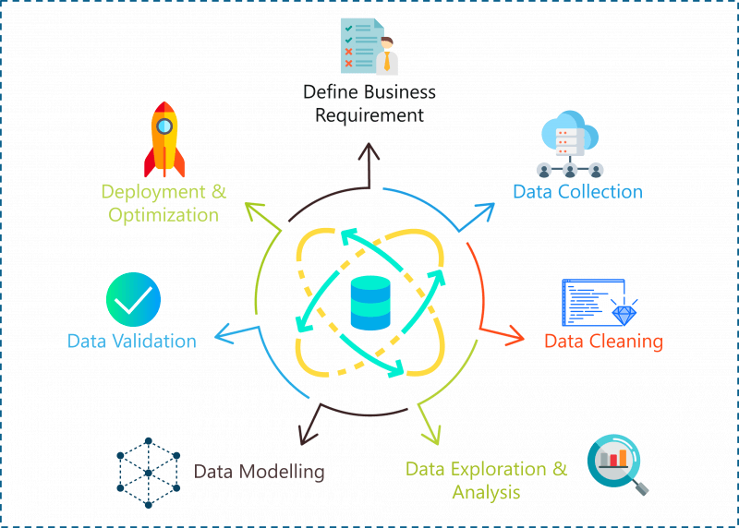
PROJECT ARCHITECTURE / PROJECT FLOW
GOOGLE API DATA SCRAPING

Slide 5
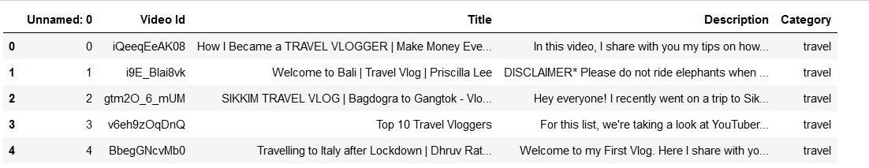
Dataset:
We mine the data using google client api.
For mining the data we have to pass the query like which videos you want to view then it will fetch query related data in json format then from json we extract the useful data like video description, video id and stored those data into csv file.
Here is mine dataset details:
Total rows: 3468
Total Columns: 5
Video Category included in dataset: 6

Slide 6
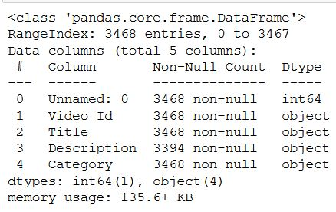
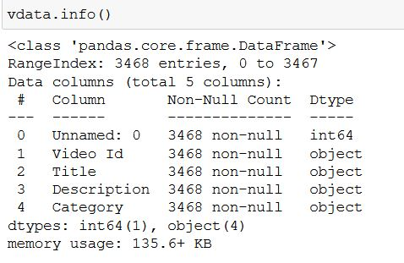
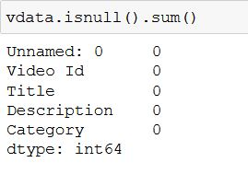
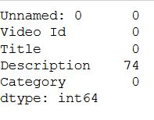
EDA and DATA PRE-PROCESSING
DATA BEFORE
DATA AFTER

Slide 7
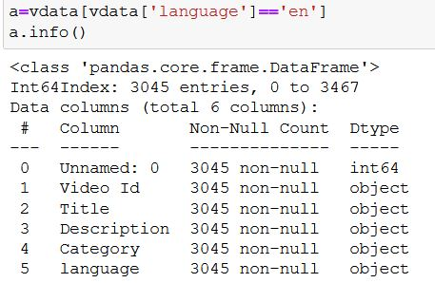
How EDA Process Done?
Total we have 74 null values present in Description. So it is replaced by white space.
On Title and Description column converted into lowercase and removed all punctuations, non alphabetic words, white space and numbers from it.
Removed all duplicated value with respect to Title column.
After mining it is seen that some of the video title has language is not English so we extracted those data which has title in English language.
After EDA Data has:
Rows: 3045
Column:6

Slide 8
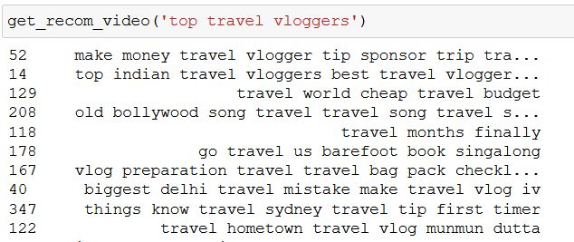
Model Building:
We have builded model using KNN and TF-IDF NLP method.
TF-IDF Method:
For this method we have merged Video Title and Description and combination of both given name as Text.
On Text column we have builded model. After converting text data into tfid matrix ,video title set as index and index of data is considered as their value and created function that will return similar videos related to given video title.

Slide 9
Disadvantage of TF-IDF Method:
User needs to pass exact video title name as present in our dataset then only user will receive similar videos.
HOW WE CAN OVERCOME THIS PROBLEM?
So solution is, we have implemented auto complete feature. So when user entering the video title, it will show list of titles that are present in our dataset.

Slide 10
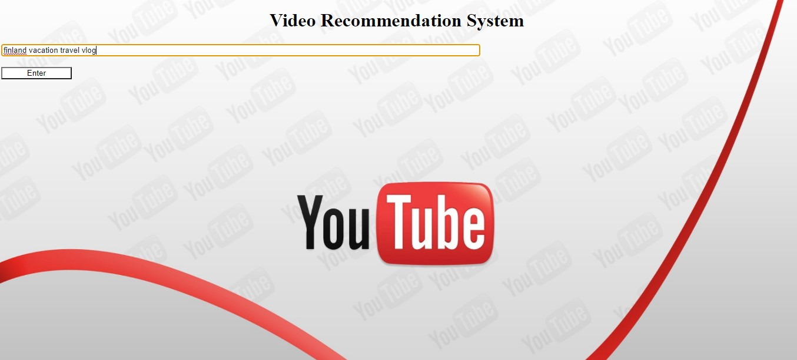
Deployment:
From above TF-IDF method and KNN method, TF-IDF method gives the more accuracy.
Deployment of our model using Flask.
Here we need to enter the video title

Slide 11
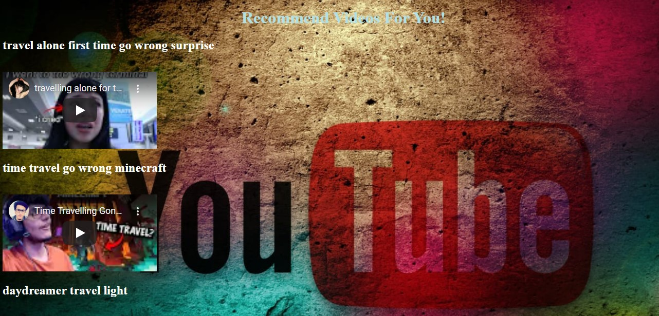
Here we get Recommended videos

Slide 12
Challenges faced ?
Collection of data
Manual entry of Video title
How did we overcome?
Here we used googleclient.api
For this we used auto complete option

Slide 13
THANK YOU

